Slide 1
Accessibility in Course Design
Melanie Coughlin
Carleton University
eCampus Ontario

Slide 2
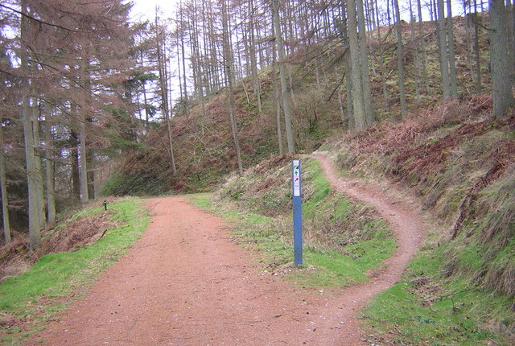
Shift in Mindset:
Accessibility
Iain Thompson / Track Choice / CC BY-SA 2.0

Slide 3
Outline
Accessible Course Outlines
Accessible Slides
Accessible Course Delivery
Accessible Online Learning Activities
Workshop Activity
Accessibility at Carleton University

Slide 4
Accessible Course Outlines
Sans-Serif Font
Table of Contents
Coded Headings (e.g., Ctrl + Alt + 1)
Descriptive Links
Word Document (.docx) and PDF
Accessibility Checker

Slide 5
Accessible Slides
Provide in advance
Font above 30 point (Slide Master)
Alt text for significant images/diagrams
Sufficient Contrast (a11y contrast checker)
PowerPoint File (.pptx) and PDF
Accessibility Checker

Slide 6
Accessible Course Delivery
Supportive Communications
Flexible Deadlines
Choices for Assignment Formats
Choices for Assignment Topics
Various Modes of Engagement
Responsive Check-Ins

Slide 7
Accessible Online Learning Activities
P
perceivable
O
operable
U
understandable
R
robust

Slide 8
Open Educational Resource Catalogues
eCampus Ontario Library
eCampus Ontario H5P Studio
Pressbooks Directory
Openstax

Slide 9
Workshop Activity
Accessibility in Course Design:
Workshop Activity (GoogleDoc)

Slide 10
Accessibility at Carleton University
Accessibility for Ontarians with Disabilities Act
Paul Menton Centre for Students with Disabilities
Accessibility Institute
Disability Justice and Crip Culture Collaboratory Research Lab
Teaching and Learning Services

